Slide 1
Shell Today App
Final Case Study Project- Custom Bootcamp
Vridhi, Harsh, Jaishnav, Suyash, Nayonika, Ritika
Software Engineering

Slide 2

Agenda
01
Introduction
02
Key Features
03
How it works?
04
GUI and Demo
05
Benefits and Conclusion
Copyright of Shell International B.V.

Slide 3

Introduction
Shell Today is an energy news web app
that enables stakeholders to stay up to date with the green energy sector in the county.
The web app is built using 3-tier architecture- React JS for self-service UI, PostgreSQL for DB and ASP.net Core Entity Framework for API.
The minimum viable product build supports filtering based on region (cities)
The web app can be scaled to accommodate more categories pertinent to the green energy sector.

Slide 4

Key Features
01
User Authentication
02
Display News Articles
03
Categorize based on region
04
CRUD operations on news articles
05
User/Admin Access Management
Copyright of Shell International B.V.

Slide 5
How it works?
React UI
Asp.Net Framework
Web API, C# Logic
Asp.Net Core
pgAdmin4 DB – User and NewsArticle Tables

Slide 6
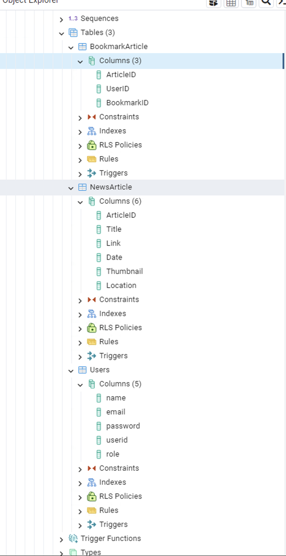
Back End-
Database
Table1- News Article (Title, Link, Thumbnail link, Location, ID)
Table2- Users (Name, Password, EmailID, ID)
Table3-Bookmarks(ArticleID, UserID, BookmarkID)
News article DB data scrapped using BeautifulSoup4.

Slide 7
Back End-
/createUser
/addNewsArticle
POST
1
APIs
/getUser
/getAllNewsArticles
/getNewsArticleByRegion
GET
2
/deleteUser
DELETE
3
/updateUser
/updateNewsArticle
PUT
4

Slide 8
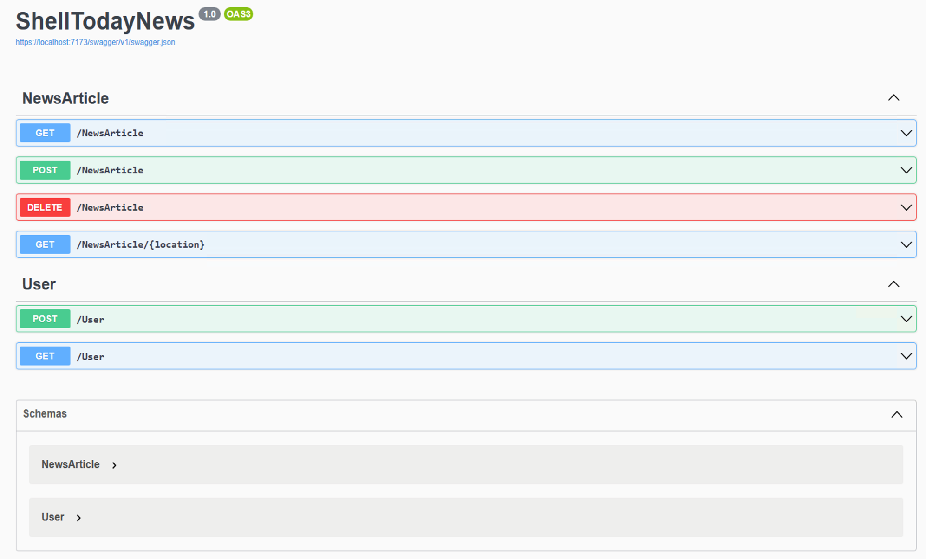
Back End-
APIs
.

Slide 9
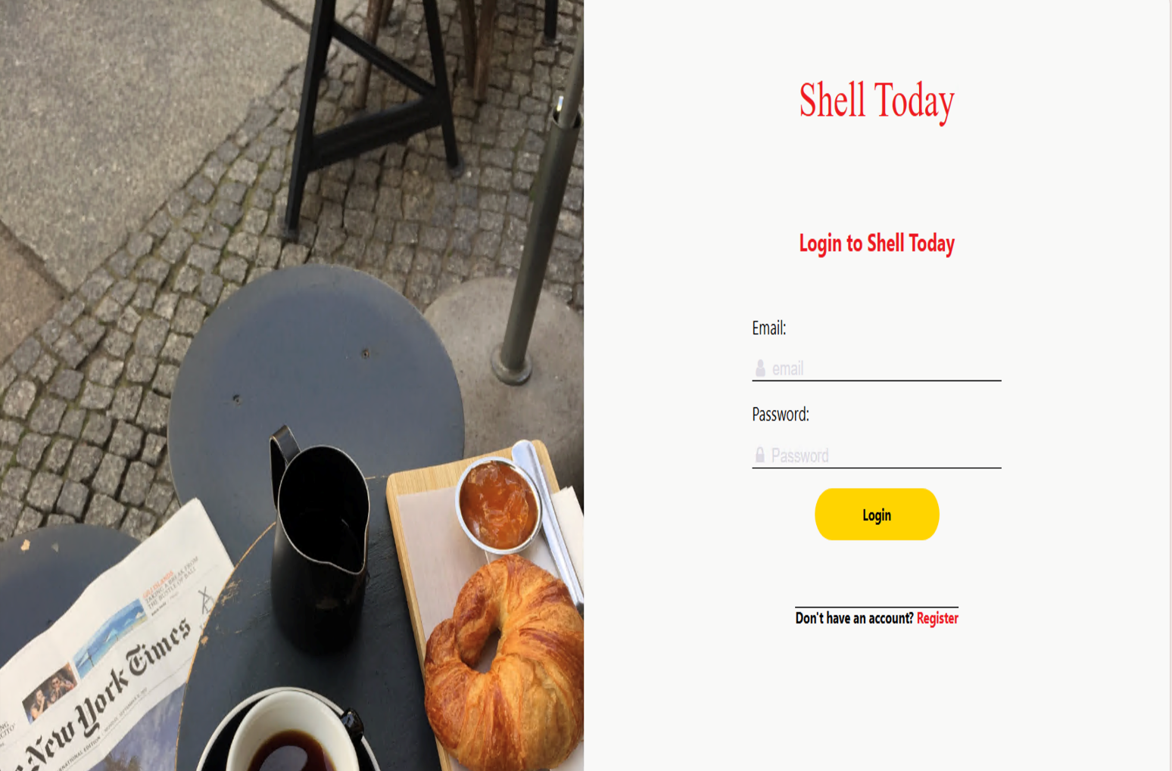
Front End-
React JS
Used React JS to develop the frontend with Client and Admin side.
Screens:
Login and Register Screen
News Articles
Profile Page
Admin Page

Slide 10
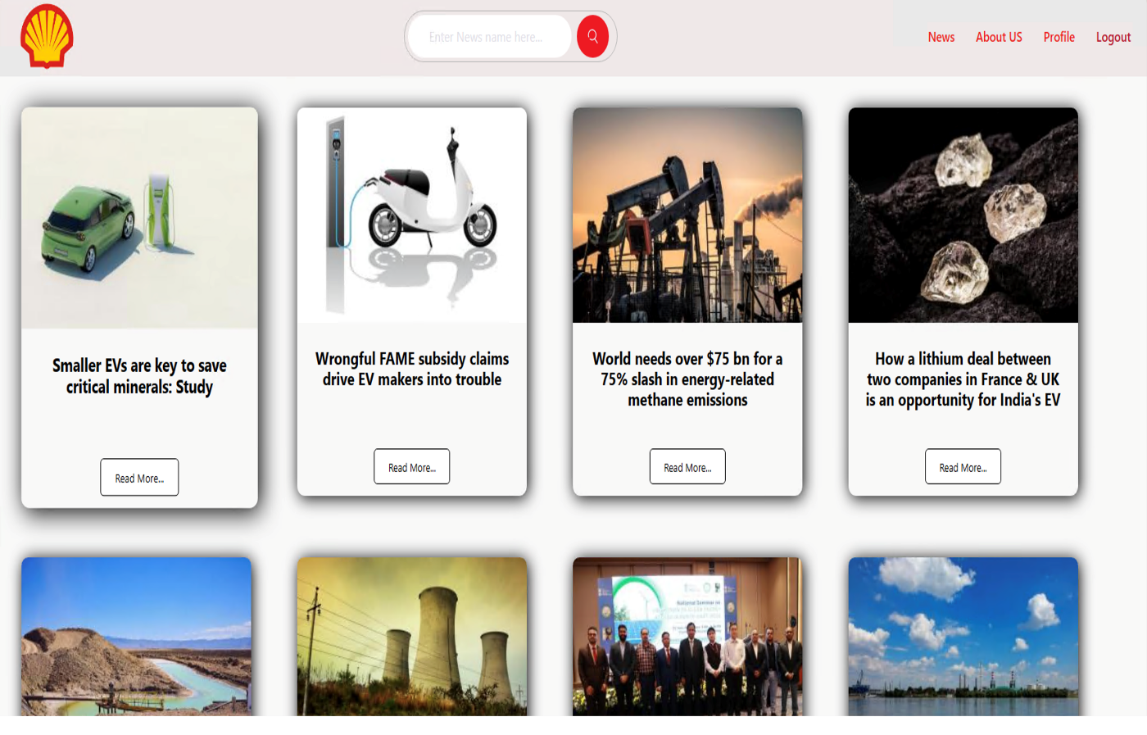
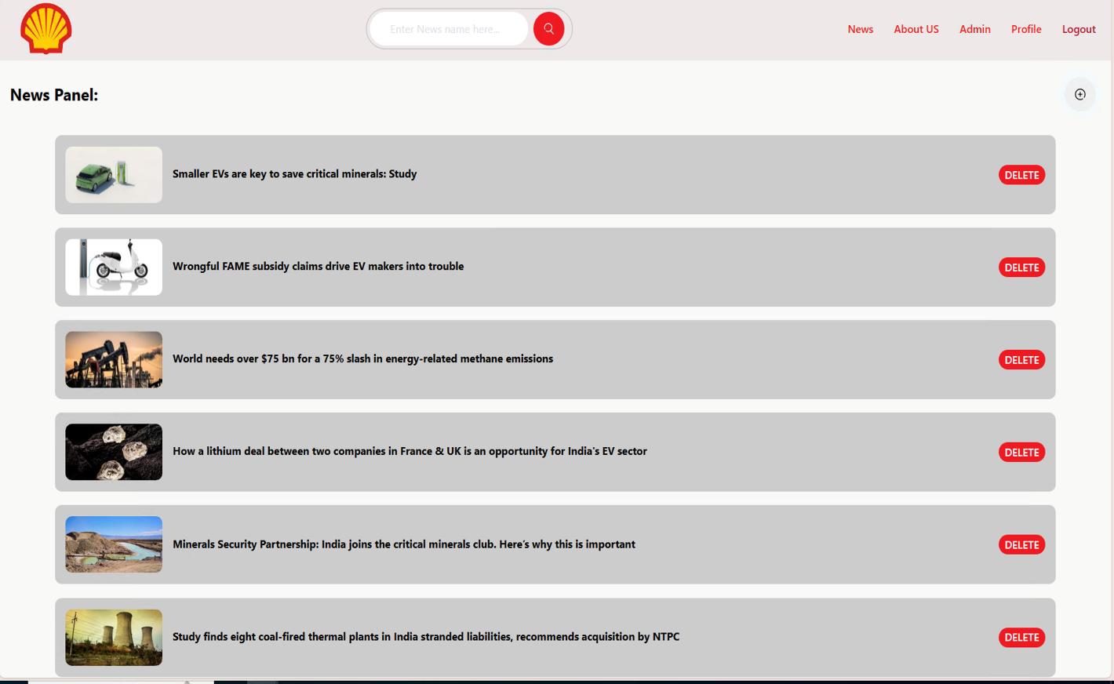
Front End-

Slide 11
Benefits and Conclusion
1. Environmental Awareness: By providing up-to-date information on green energy developments, fostering a greater understanding of the importance of sustainability and eco-friendly practices.
2. Access to Credible Information: Ensuring that they receive accurate and trustworthy information about renewable energy technologies and environmental initiatives.
3. Promotion of Sustainable Choices: Empowering users to make informed choices that reduce their carbon footprint and contribute to a more sustainable future.
4. Community Building: The platform creates a community of environmentally conscious individuals who can share knowledge, engage in discussions, and collaborate on environmental projects, fostering a sense of community and collective action for the environment.

Slide 12
Thank you

